Slide 1

Time Complexity
Tech Talent Pipeline Summer Bootcamp
By Ariel Avshalom

Slide 2
Highest exponent
When analyzing algorithms, the general case is that the higher exponent variable matters more than all other terms
Why do you think this is the case?
Notes:
Here we talk about how constants, multiples and lower exponents stop mattering when large inputs are fed.

Slide 3
Wait, so no other terms matter?

Slide 4
No
Well…sort of
Big O is used to approximate running times, often to an upper limit
The four aspects you need to know are
Ability to add Big O complexity costs
Ability to drop constants
Different inputs have different variables
Drop non-dominate terms

Slide 5
Segway to O-notation
Watch this video by Gayle Laakmaan Mcdowell which introduces big O notation:
https://www.youtube.com/watch?v=v4cd1O4zkGw
Notes:
Have students watch the video, pause and explain if in person through the 4 concepts.

Slide 6
Avoid the math, focus on the concepts
There’s a lot of math behind Big O
Focus on the ideas
There are upper bounds (Big O), lower bounds (Big Omega) and in-between bounds (Big Theta)
Notes:
Depending on how you teach this, tweak the page. Maybe the math is super duper important for you.

Slide 7
O, Ω and Θ
Notes:
The definitions below are very technical, thinking about it as upper, lower and a well fitted bound is a good idea.

Slide 8
Big O and little o notation
Big O is written like so:
F(n) = O(g(n)) if f(n) is asymptotically less than or equal to g(n)
It is the asymptotic upper bound
Little o is written like so:
F(n) = o(g(n)) if f(n) is asymptotically strictly less than g(n)
We rarely ever use little o notation (but it can appear in exams and homework)
Notes:
Students often mix up big o and omega in the technical definitions. Examples help a lot.

Slide 9
Ω and ω (little omega) notation
Big Ω is written like so:
F(n) = Ω (g(n)) if f(n) is asymptotically greater than or equal to g(n)
It is the asymptotic upper bound
Little ω is written like so:
F(n) = ω(g(n)) if f(n) is asymptotically strictly greater than g(n)
We rarely ever use little ω notation (but it can appear in exams and homework)
Ω is similar to O except that it is the asymptotic lower bound

Slide 10
Θ notation
This is the middle ground
F(n) = Θ(g(n)) if f(n) is asymptotically equal to g(n)

Slide 11
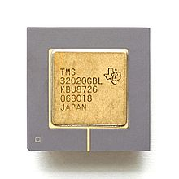

Let’s paint a story
Check out this handy Wikipedia entry about the evolution of computer speed
Consider the Texas TMS320 core and compare it to the AMD Ryzen ThreadRipper
TMS320 has 5 MIPS (million instructions per second)
The ThreadRipper has about 2,400,000 MIPS
Probably the best chip set out there
Comparative chips have about 700,000 and 400,000 MIPS
Let’s play a speed game with algorithms
Notes:
Over here, we will compare two or three algorithm speeds with two CPUs of different magnitudes of power and across different inputs.
I usually choose the 1983 TMS320 with 5 million instructions per second vs the Ryzen Thread Ripper with 2.4 million million instructions per second (usually change it to 5 million million instructions per seconds. I showcase the difference in power across generation with the Wikipedia article.
Then one algorithm is with the TMS and runs at something like 50 N + 700
While the other algorithm is on the Thread Ripper and runs at 2N^2 + 50 or something similar.
I feed in inputs of 1,000, then 100,000, 10,000,000 then 10,000,000,000.
As I do this, I show how we can drop constants and coefficients since they really don’t make a difference with large enough inputs.
Eventually the TMS will win with it’s low power but efficient algorithm!

Slide 12

So you see
When looking at large computations, which is what often happens in the real world (think Google) the highest exponent becomes the most important measurement
It’s nice to be able to do an exact analysis, and we may do this during examinations (and you might do so in interviews), but it doesn’t matter much

Slide 13
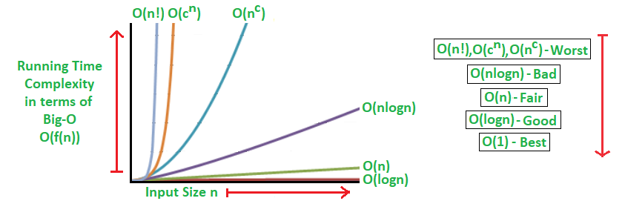
Hierarchy of Functions
There is a hierarchy of functions which increase with a rising exponent
Part of your first homework will be to order a bunch of these
Here is how it’ll look

Slide 14
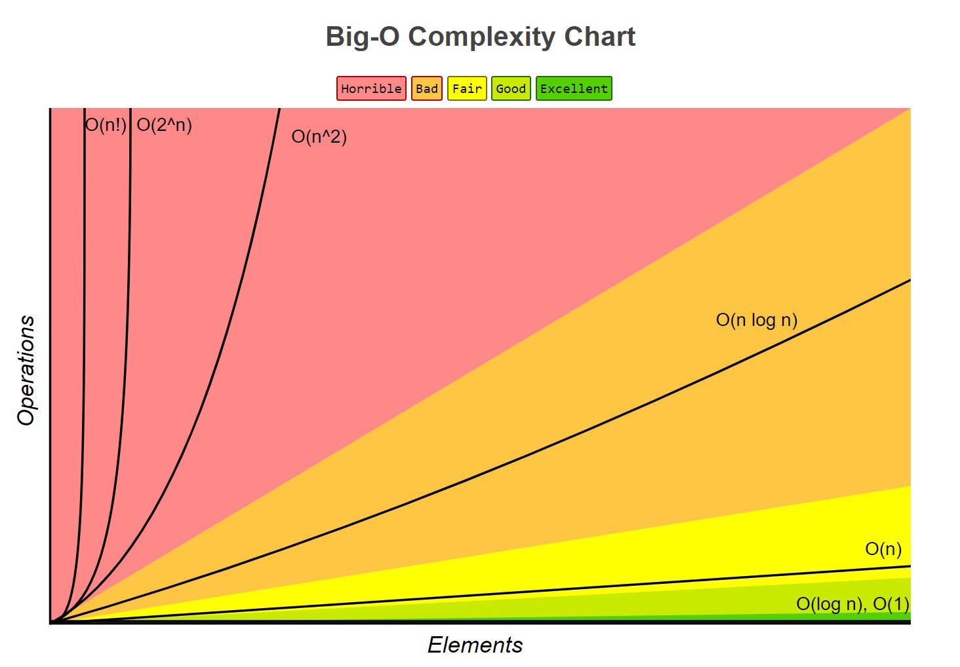

Slide 15


An interesting function comparison log * (n) and Ackermann
Right between the constant function and the log(log(n)) function, the is the log * function
The log * function counts the amount of times we run the log function on a number before we reach 1
The Ackermann function takes n and produces this exponent:
$2^{2^{2^{2^{…^{2}} }}}$exponent to the nth time
These two functions are connected and are on the opposite sides of the hierarchy
Fun fact: Ackermann is a total computable function that is not primitive recursive
I.e.: it is computable but not with for loops

